Slide 1
Software design and Analysis
Lecture 03

Slide 2
Outline
Purpose of software
Complexity of software
Reason for software complexity
Resolving Complexity

Slide 3
Purpose of software
What is the purpose of software?
Perform complex tasks/calculations
Ease complexity
Reduce human intervention
Reduce errors
Perform monotonous work
...
Is developing software is complex?

Slide 4
Software Complexity
Many objects in this world exhibit great complexity
Heart beating, photosynthesis weather etc.
Applies to software as well
Database system
Financial system
Air traffic controller
This complexity is too great for one person to understand
Complexity can never be eliminated; but it can be reduced

Slide 5
Reasons for software Complexity
Problem domain complexity
Some domains are complex e.g. finance, telecom etc.
Lends itself to software
Non-functional requirements, such as usability, performance, cost, etc. add to overall complexity

Slide 6
Reasons for software Complexity
Communication between users and developers
May have vague idea of what they expect from software
Difficult for user to express their requirements
Developers expect requirement in a specific format (e.g. UML)
Both user and developers may lack domain experience
Users get a better idea of the system only after seeing prototypes or design documents
May request a change that is difficult to incorporate

Slide 7
Reasons for software Complexity
Volatile nature of requirements
Requirements change
May be difficult, if not impossible to incorporate that change
Future changes must be anticipated

Slide 8
Reasons for software Complexity
Unpredictable behavior of software
Software runs of systems with discrete components
Application may have multiple threads, variables, memory allocations
Large numbers of events and states
Cause combinatorial explosion
Interaction between components

Slide 9
Reasons for software Complexity
Developmental process
Big teams
Geographical locations
Communication/coordination between developers
Resource shortage

Slide 10
Summary
Software solves problem & reduces complexity
Writing software is complex
Factors such as domain, requirements, etc., contribute to complexity of the software

Slide 11
Resolving Complexity
Human beings is built-in mechanism for dealing with complexity
Decompose each part into smaller parts till each part makes sense individually
Finally, integrate the parts to build the final system
“divide et impera” – divide and rule
Ancient rule to conquer the state or component and Same principle is applied to programming languages

Slide 12
Algorithmic Decomposition
Decompose problems into algorithms
Each algorithm is part of series of steps (part of overall process)
Typically a top-down approach
Start with a big picture
Break down into smaller chunks
These lead to final result(like a flow chart)

Slide 13
Example
Write a software to help tutor prepare a report card for their students
The software will
Accept students details (name, roll number , class)
Accept test details (semester/unit)
Accept subject name and score
Calculate total score
Calculate average score
Assign grade
Display lowest & highest scoring subjects (based on the threshold)

Slide 14
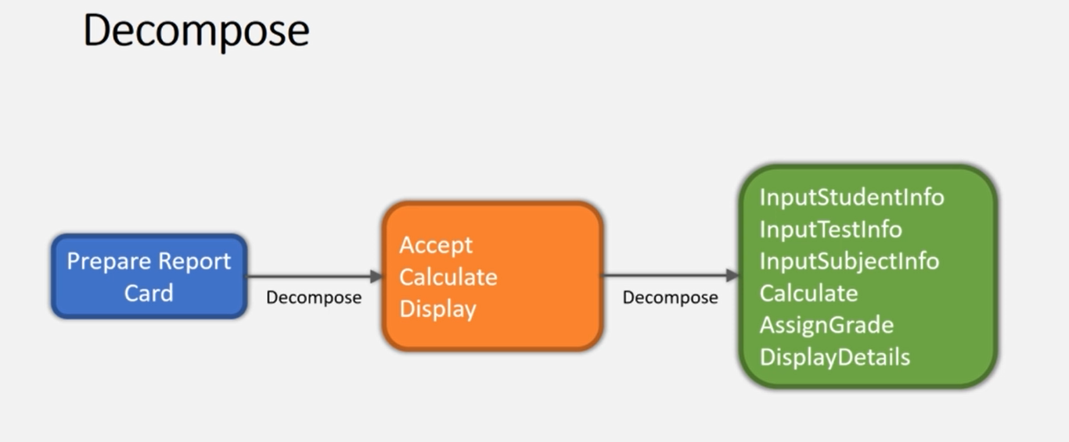
Decompose

Slide 15
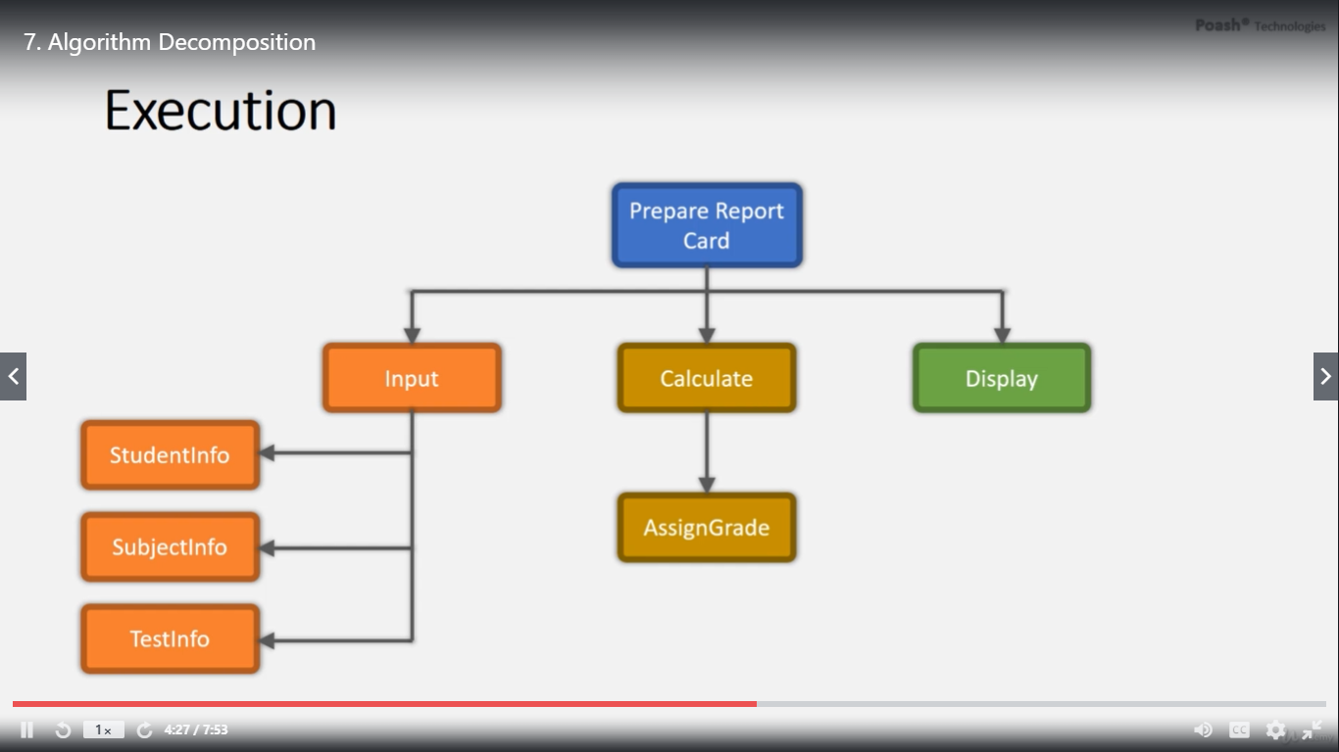
Execution

Slide 16
Disadvantages
Development based on the high-level specification
Algorithms are very specific to the application, thus, difficult to reuse
Often changes over time
Parts have to be rewritten
Difficult to add new features
Algorithm are tightly wired to work together

Slide 17
Disadvantages
Data is treated with low significance
Data is shared between algorithms
Unintentional modification can lead to disastrous results
Focus on operations
No idea about the entity on which operation is performed
Overall understanding of the application becomes complicated
Doesn't map to real life entities

Slide 18
Languages
Languages based on algorithmic decomposition
Fortran, Cobol, Pascal, c, etc.
These are the initial programming languages that were created to solve scientific problem and performing mathematical operations.
The system based on these languages are
Driven in size
Complex
Do not at risk with problem associated with reusability, scalability and maintainability

Slide 19
New way to resolve complexity
Object Oriented Decomposition

Slide 20
Summary
Algorithmic decomposition
Focus on operations rather than data
Dosent scale well
Doesn’t map to real world

